Slide 1
Proposal to Manufacture & Supply Covid-19 PPE
FACESHIELDS,FACEMASKS & OTHER PERSONAL PROTECTIVE EQUIPMENT FOR HEALTH CARE AND THE PUBLIC

Slide 2

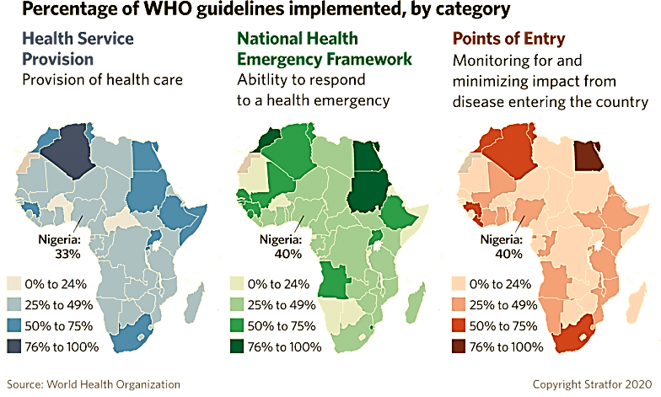
Introduction
Given the overwhelmingly disorienting conditions and health threats currently being faced by the global economy, the need for innovation and smart investments in businesses and products that mitigate the risk of infection has arisen.
The effective protection for front line staff & the public have become essential.
Studies have shown that humans touch their face between 20 to 50 times an hour and our products aim to effectively address this problem.
Methods/Products which can limit the transmission of the virus and decrease contamination of the nasopharynyx and human face in general are in high demand in countries actively trying to address the spread of the virus.
Considering the massive ongoing disruptions to supply chains, this business model could potentially capture the entire West African consumer base if acted upon in a timely manner.

Slide 3
Investment Proposal Options
(B1) Setting up a state of the art 3d printing facility
(B2) Trade Agreement for Supply of PPE
Investment in local manufacturing capability to print face shields.
Circumnavigate the disrupted supply chains and secure the consumer base for PPE in West Africa.
High profit margins and value adding capacity for the manufacturing sector.
Supply and distribution of crucially needed PPE to Hospitals/Clinics
Items include: Disposable gloves and Isolation gowns, Forehead thermometers, Covid-19 Antibody Test kits.
Provision of a consistent supply of PPE to front line staff.

Slide 4
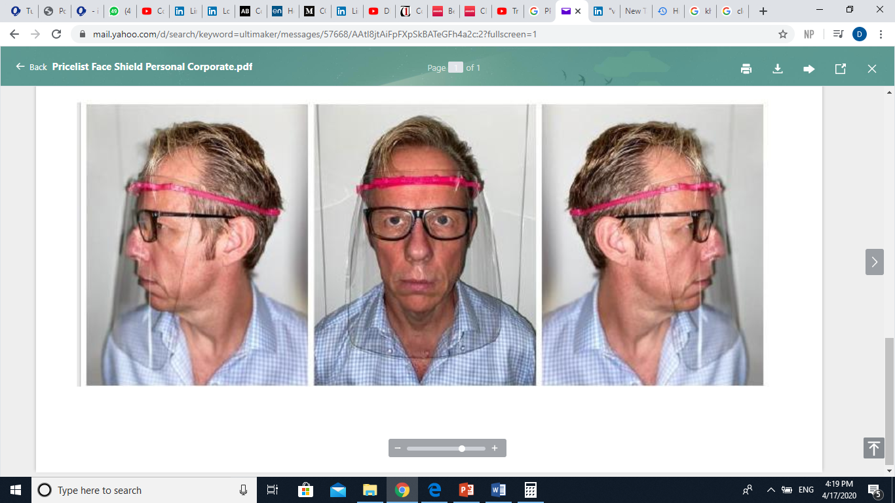

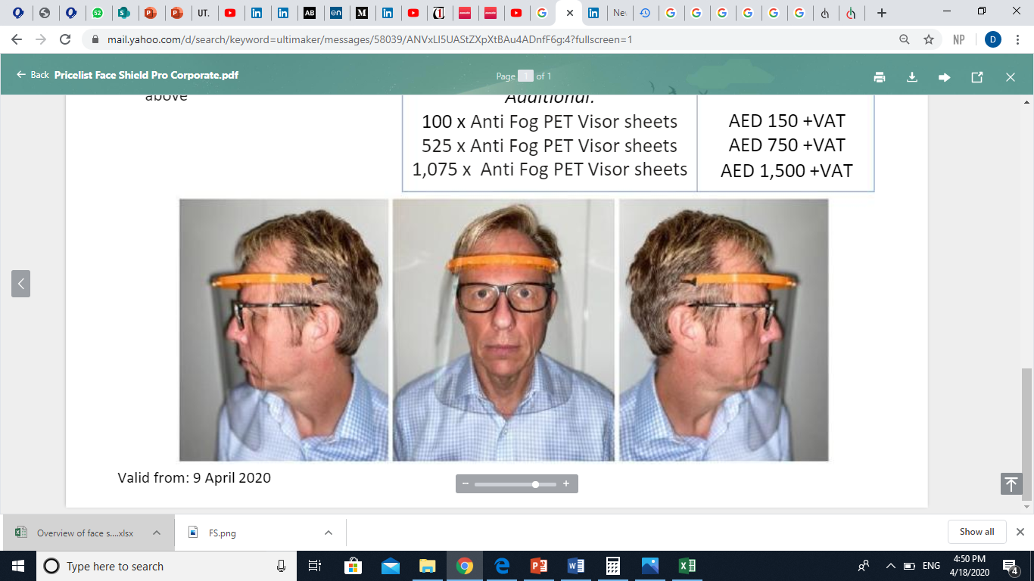
Main Product Description
Unlike traditional face masks, the plastic face shield can be wiped down with a disinfectant for reuse, and protects the entire face.
These face shields can aid in curbing the spread of coronavirus in two ways
Prevent individuals from touching their faces and noses.
Offer a 180 degree closure of the face from aerosols and spray droplets of the corona virus

Slide 5
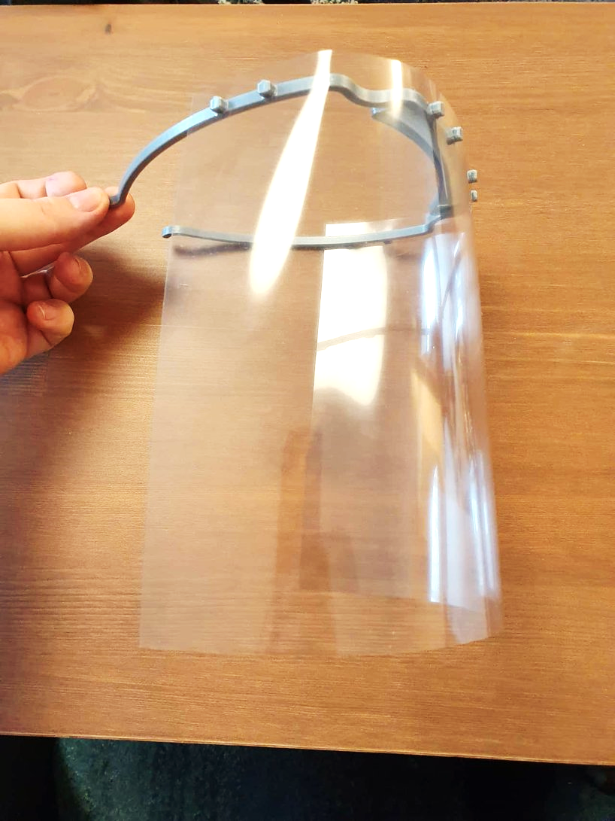
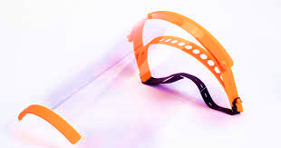
(B1) - Face Shield Design Options
Personal
P3 (Professional)
Lower production cost and print time .
Suitable for use by essential workers and members of the public.
Slightly higher production costs, more components & longer print time.
Compatible for use by frontline staff due to the sturdy fit which allows fluent maneuverability.

Slide 6
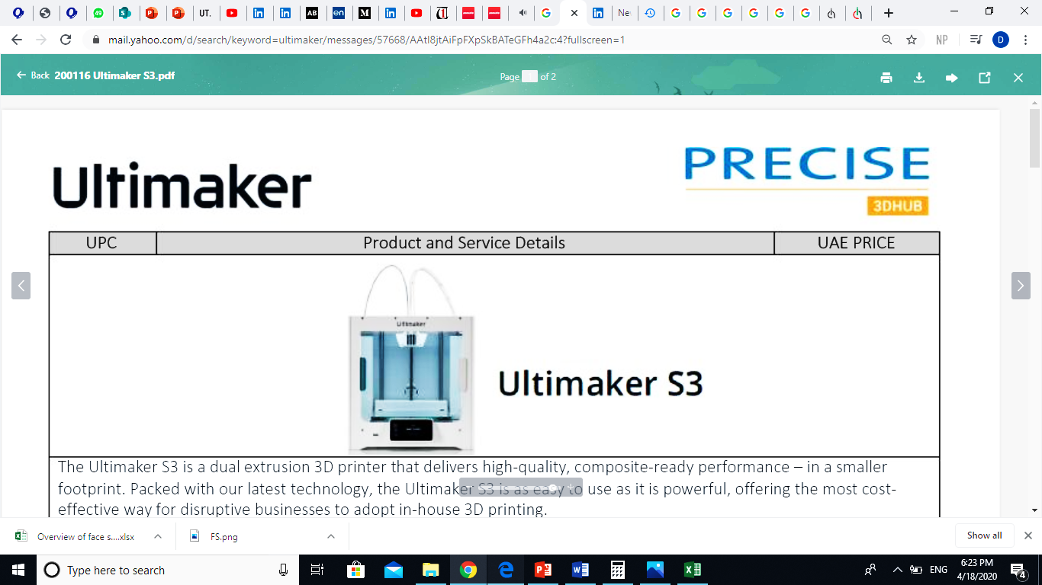
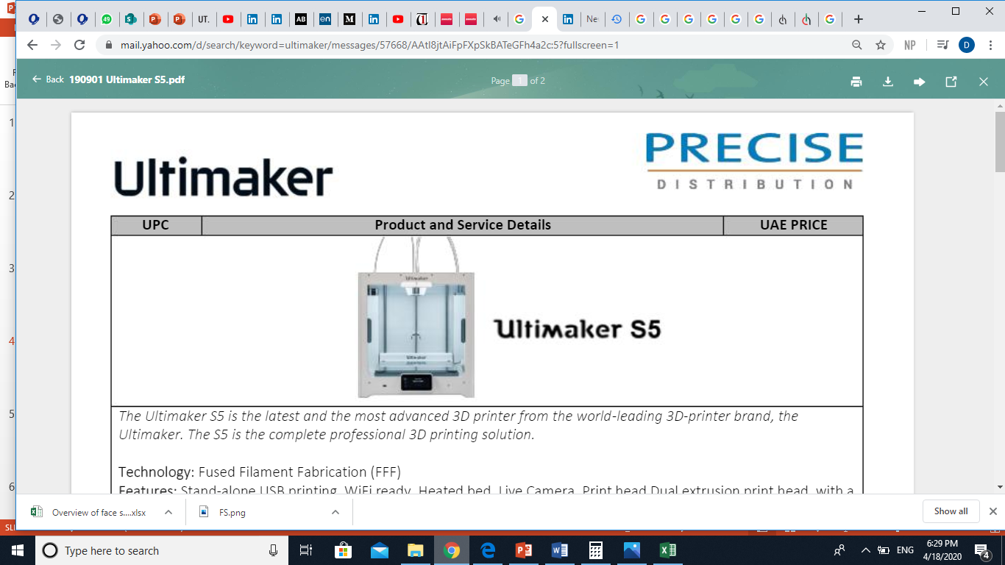
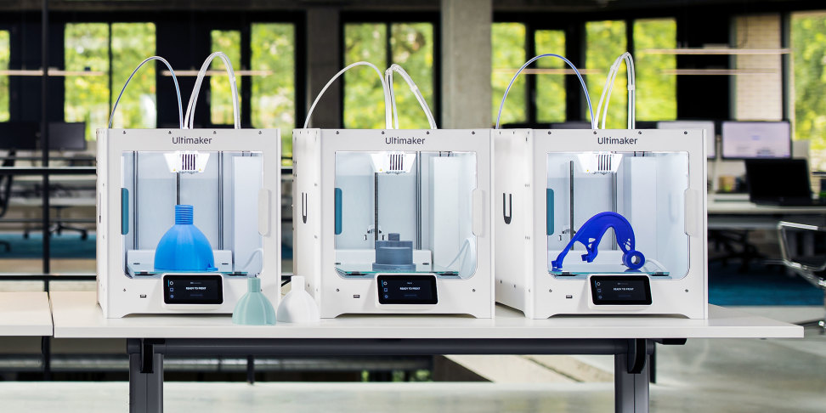
Business model (1) -Investment in 3d Printing Fabrication
Manufacturing Re-usable 3d printed Face shields.
A linearly optimized combination of the S5 , S3 & S2+ Ultimaker 3d printing machines
The mechanism of the printers is Fused Filament Fabrication.
High Quality, Composite ready performance on prints for various applications is guaranteed.
These printers are the next frontier in the manufacturing industry & can be easily adapted to make other products post the Covid-19 crisis.
The printer can also be used to train teenagers and Youth Corpers on 3d modelling and fabrication.

Slide 7
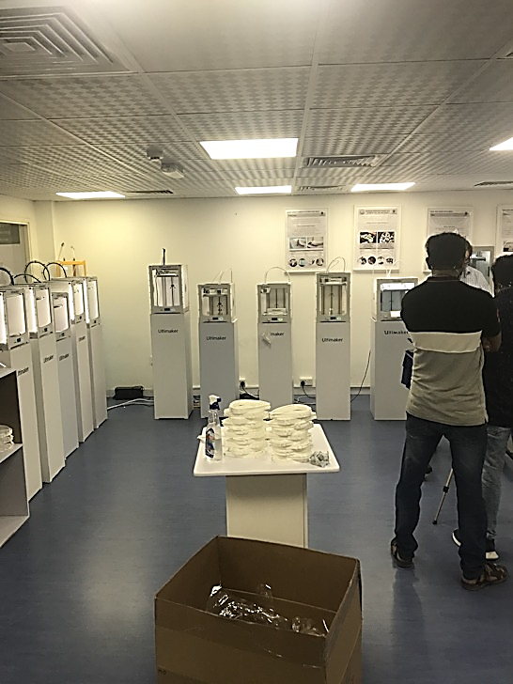
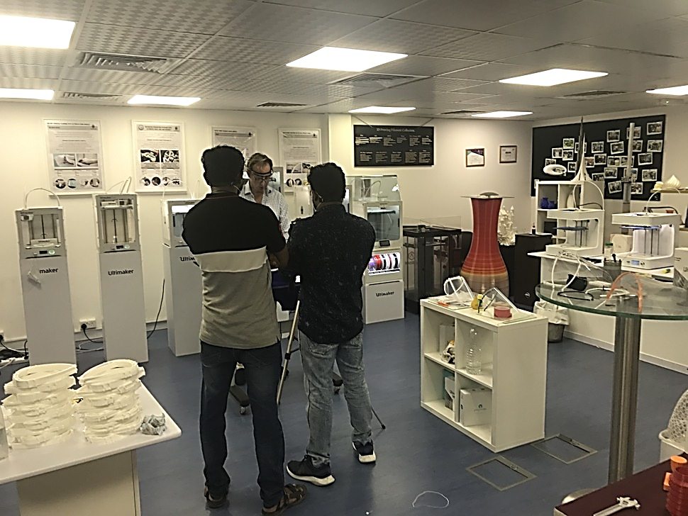
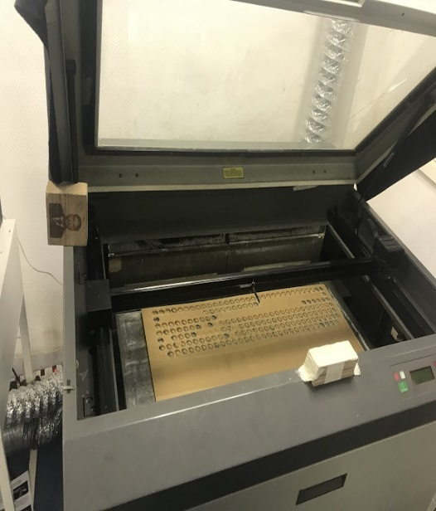
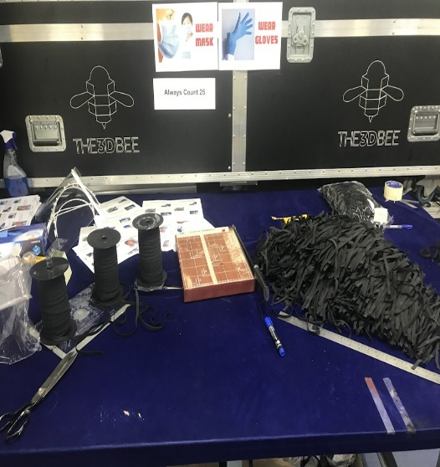
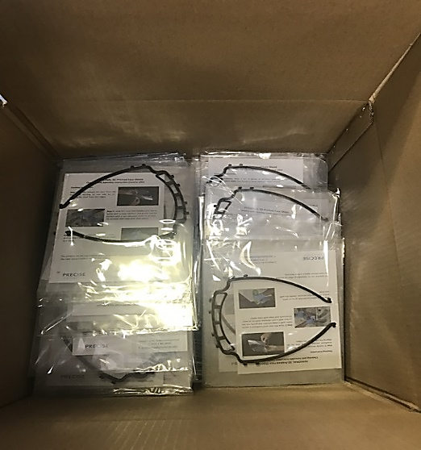
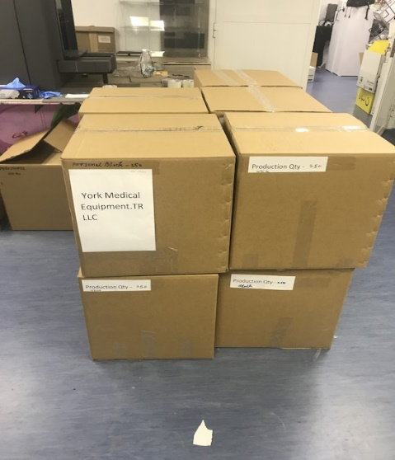
(B1) - Proposed Factory Flowchart
Assemble
Laser Cut Visor
3d Print Head Band
Cut Ribbons to size
UV Light curing
FACTORY LAYOUT AND SPACE REQUIREMENTS {50-60 sq. meters}
SCHEMATIC OF THE 5 OPERATIONS REQUIRED TO OBTAIN FINISHED PRODUCT.

Slide 8
Includes: Cost for setup and 2 month operation
Business Model (1) - Cost Breakdown

Slide 9
(B1)-Cost Benefit Analysis
Production capacity and Unit prices of Product based on 15 printers
Production capacity per month with 15 printers 18 514 (personal) or 9257 (professional) face shields.
Price per unit : professional face shield = ₦2500/$6.53
Price per unit : personal face shield = ₦1800/$4.63
Consumer base: Approximately 23,640 Public & Private Hospitals in Nigeria.
Hospitals/Clinics in West Africa and Members of the public.
Total Cost of Setup VS Gross Revenue
Investment required for procurement of 3d (Printers/Filaments/Training/Electricity consumption/Spare Parts/Shipment/Engineers wages)
₦ $113,400/$44,578,800
Break even point on investment assuming 24 hour operation of factory = 6 weeks
Revenue after 2 months of operation
₦ 57,000,000/$140,167
Revenue after 6 months of operation
₦ 171,000,000/$438,500

Slide 10
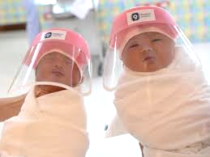
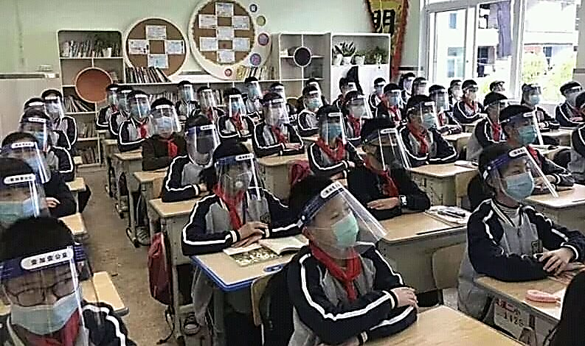
B1 & B2 - Market forecast and Consumer Base
With the growing number of covid-19 cases and the mounting pressure to ease the breaks on the economy.
The lockdowns imposed all over the world are bound to be relaxed
PPE for the public and healthcare workers will be vital in controlling the propagation of the disease in Africa within this period,
This face shields are already being employed in maternity wards in Thailand and South Korea to provide an extra layer of protection to newly born babies.
China has also deployed them in use in educational environments, so the need for preventative equipment such as this are definitely key to re-opening the economy before arrival of vaccines.
These Face shields are currently only being supplied to Kenya & Tanzania considering the African Market.
This could be the first 3D manufacturing hub in West Africa and sets the model to aid transition from reliance on global supply chains for PPE by Africa's most populous Nation.

Slide 11
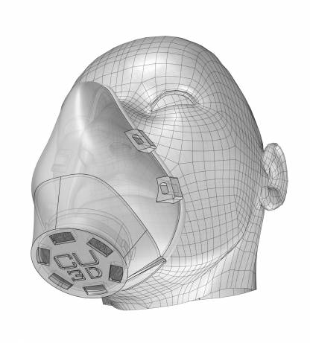
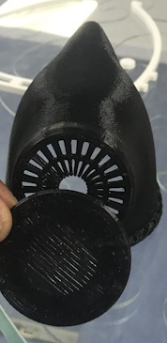

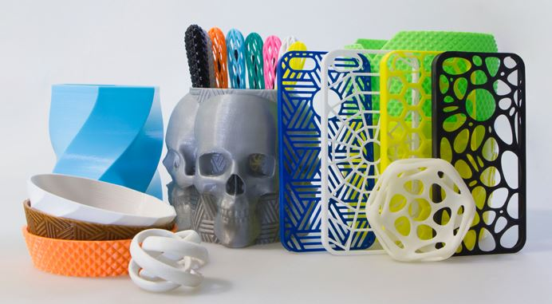
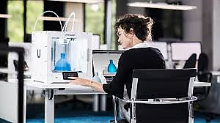
Business Model (1) - Post Covid-19
Education
Manufacturing other Products
This investment in 3d Printing capability could be adapted for vocational training and manufacturing apprenticeship programs.
3d modelling classes and training courses on Design for Manufacture.
Antibacterial Face Masks.
Dental equipment.
Special request orders.
Ornaments & Souvenirs.
Valves, Washers, Nozzles and automobile fixtures.

Slide 12
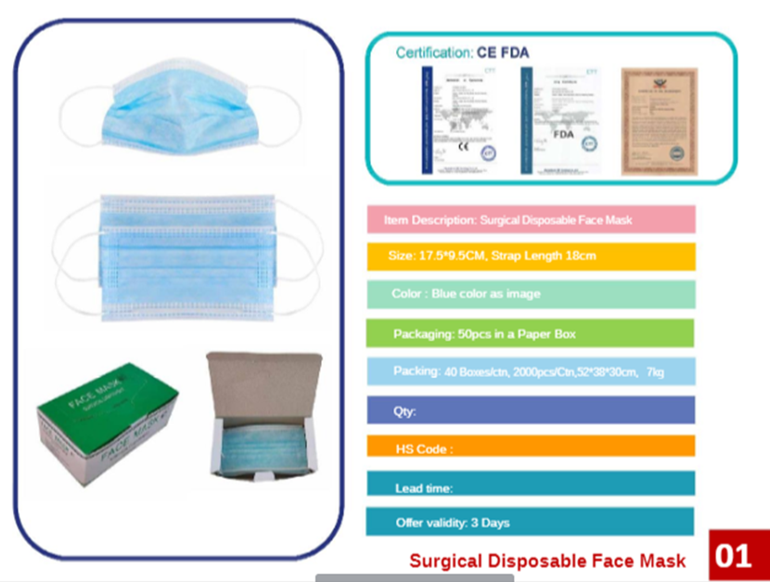
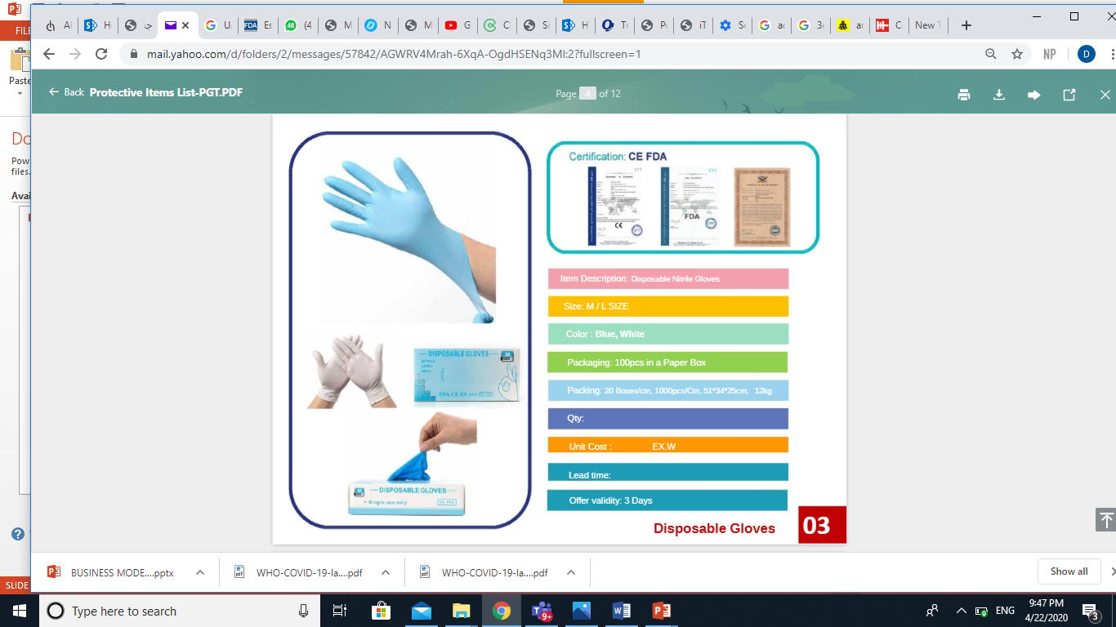
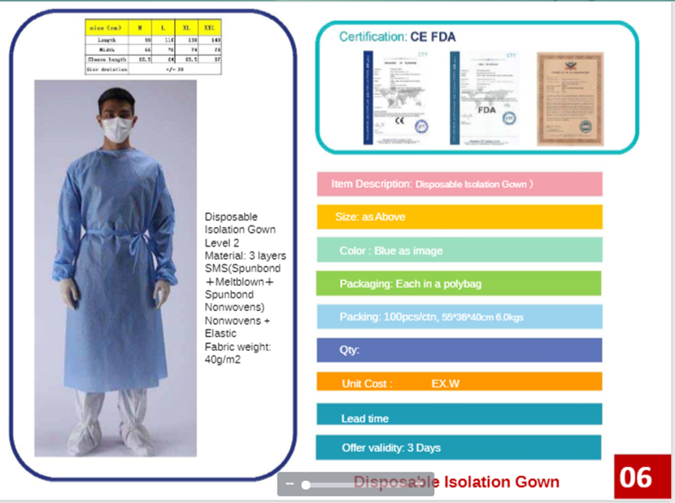
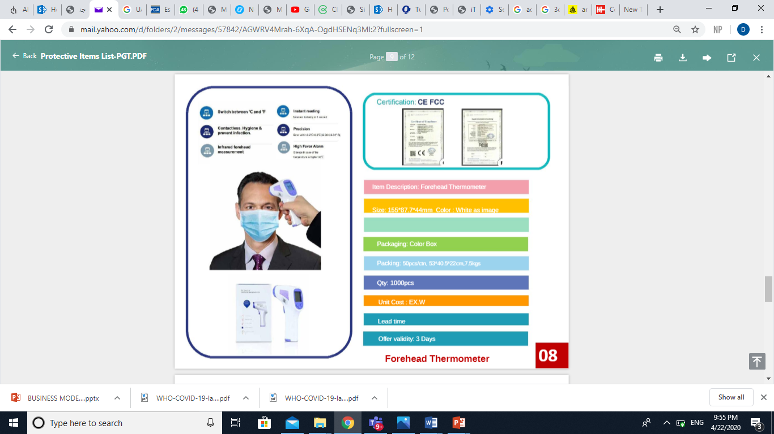
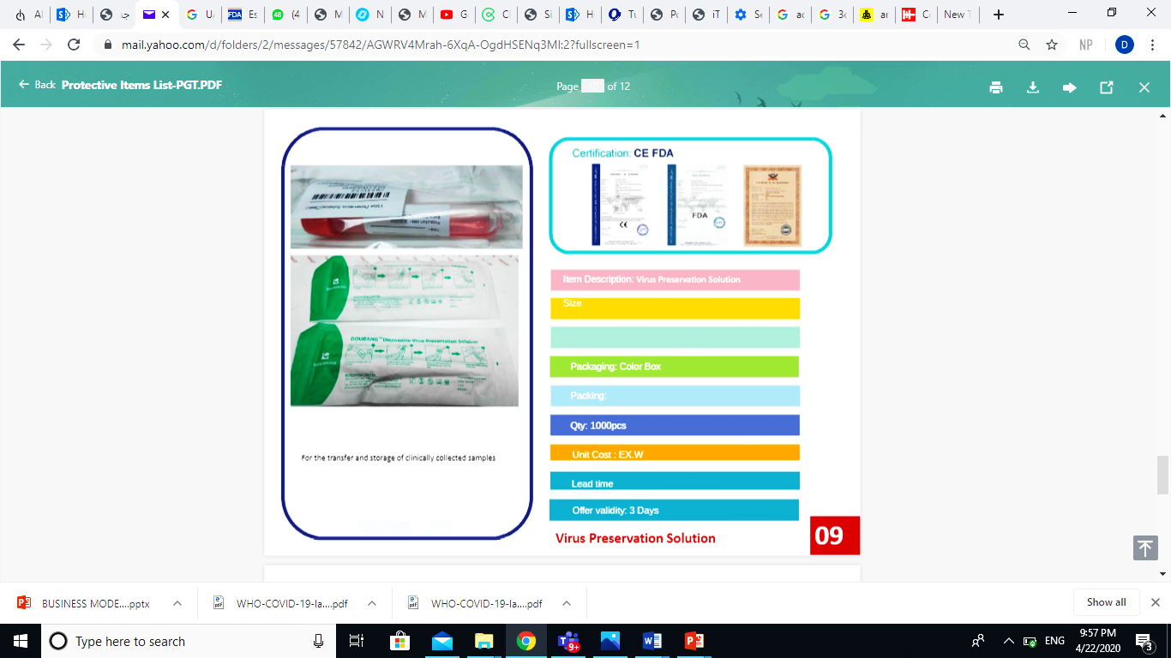
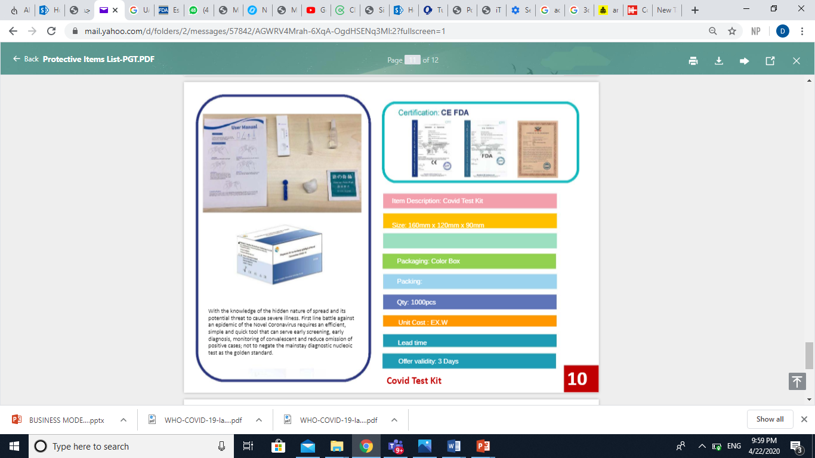
Business Model (2) - Items Available for Supply and Distribution Only
Unit costs and Lead times will be provided on request.

Slide 13
CONCLUSION AND CONSIDERATIONS
This Business model takes into account the constantly fluctuating state of the economy and global supply chains. It aims to achieve positive productivity growth and enable supply of critically needed PPE on the African continent.
Timely action will allow for domination of the African market and secure a consumer base for PPE in the region.
Establishing a good working relationship with Precise Trading grants access to ventilators, Covid 19 Test kits and critical information pertaining to manufacturing of antibacterial copper infused face masks.
The potential of a transition to education and vocational training platform past Covid-19 also presents exciting opportunities for raising awareness on the capability of the latest technology in manufacturing within Nigeria.
It is important to note that a good proportion of the sanitization and PPE mannerisms picked up during the covid-19 crisis will linger in the global community long after the vaccines have been developed and mass produced. This is likely to have a prolonged positive impact on the demand of products like the re-usable face shield and antibacterial facemasks.

